Slide 1
4-5th Generations of Computers

Slide 2
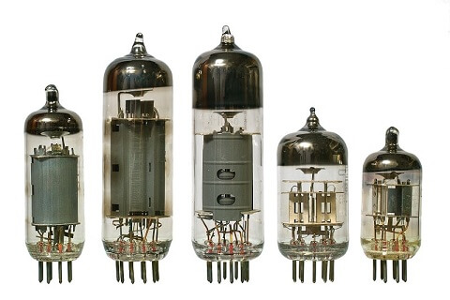
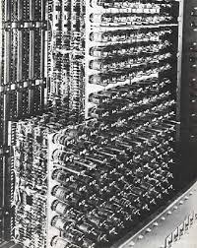
Vacuum Tubes

Slide 3
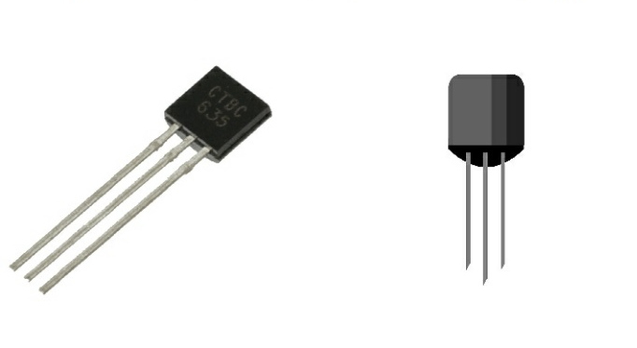
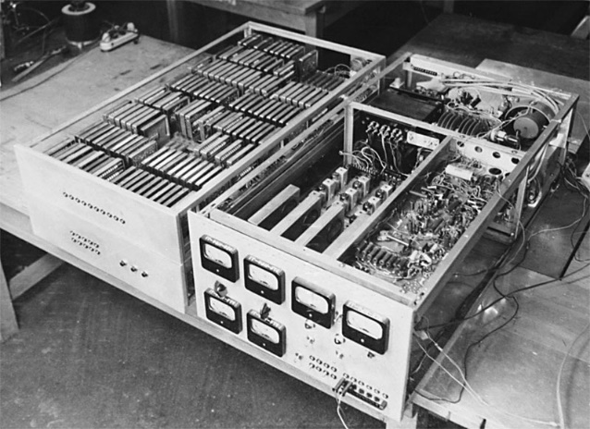
Transistors

Slide 4
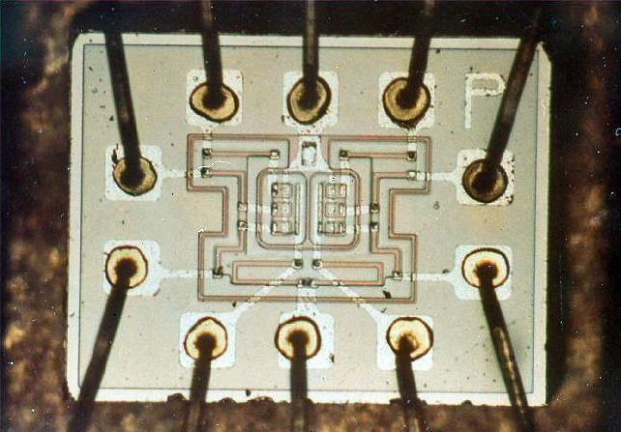
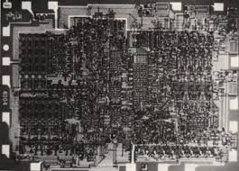
Integrated Circuits

Slide 5
4th Generation

Slide 6
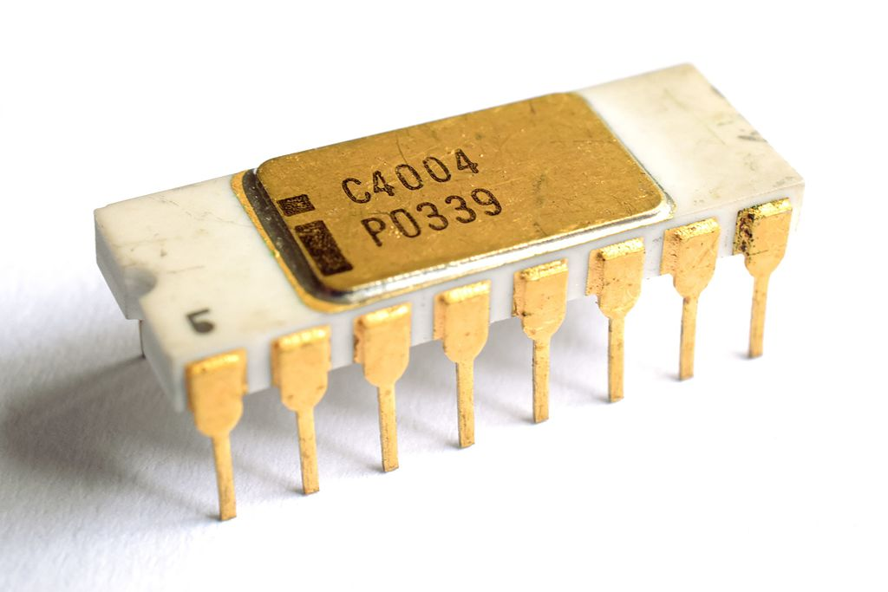
1971-1980
The first
Intel® 4004
microprocessor

Slide 7
Microprocessors == VLSI chips

Slide 8
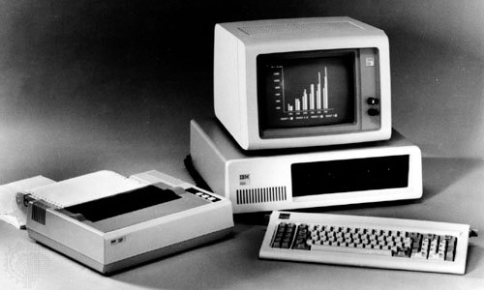
The IBM Personal Computer (PC) was introduced in 1981. Microsoft supplied the machine's operating system, MS-DOS (Microsoft Disk Operating System).

Slide 9
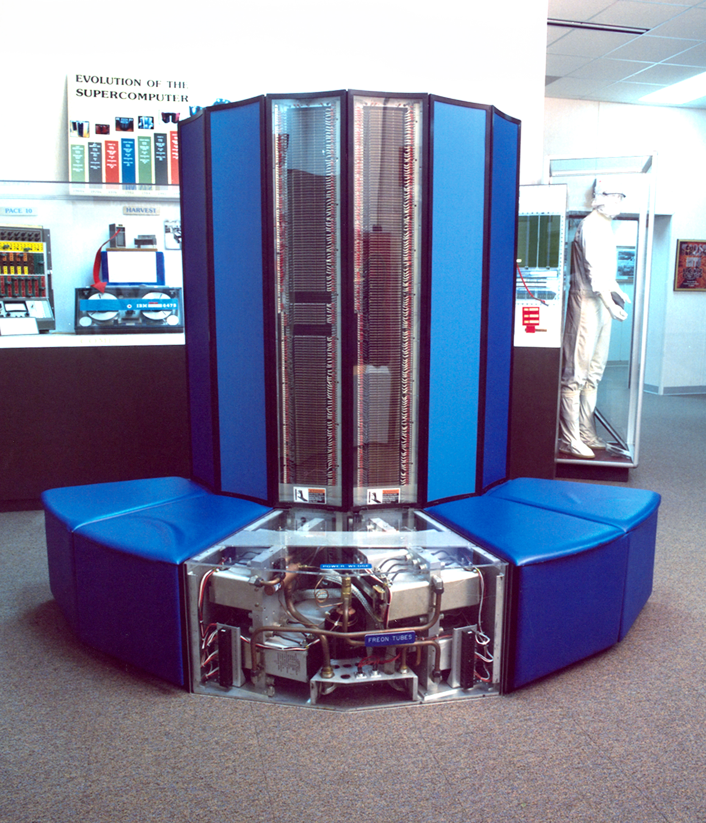
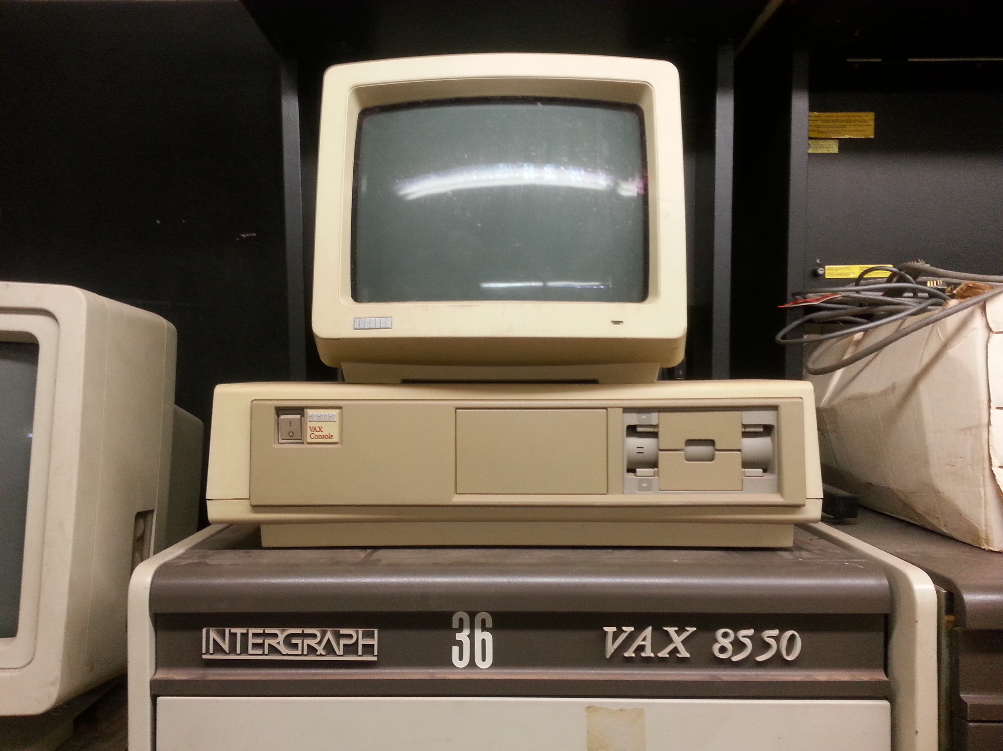
CRAY-X-MP
(Super Computer)
DEC 10

Slide 10
5th Generation

Slide 11
1981 - our days
VLSI
→ ULSI

Slide 12

AI

